Slide 1
Neural Architecture Search
S’24 DL Fundamentals and Applications
03/19/2024

Slide 2
Paper Details
Original Paper Written By : Barret Zoph∗, Quoc V. Le (Google Brain Team)
{barretzoph,qvl}@google.com, (g.co/brainresidency.)
Conference paper at ICLR 2017

Slide 3
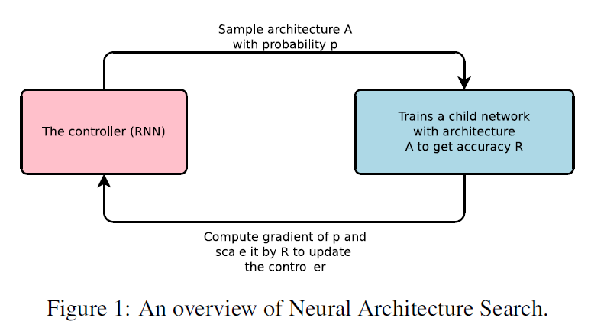
Abstract
Implemented a recurrent network for generating model descriptions of neural networks.
Trained the recurrent network using reinforcement learning to maximize expected accuracy on a validation set.
Demonstrated the effectiveness of the approach on the CIFAR-10 dataset.
Starting from scratch, the method designed a novel network architecture comparable to the best human-invented architecture in terms of test set accuracy.
Achieved a test error rate of 3.65 on the CIFAR-10 dataset.
Outperformed the previous state-of-the-art model with a similar architectural scheme by 0.09 percent in accuracy and 1.05x in speed.

Slide 4
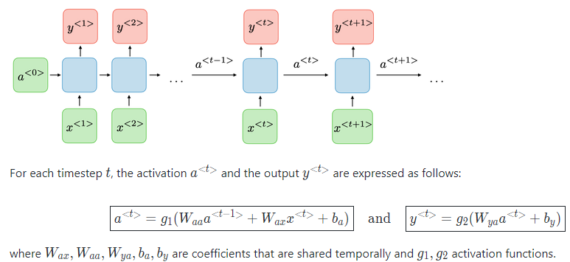
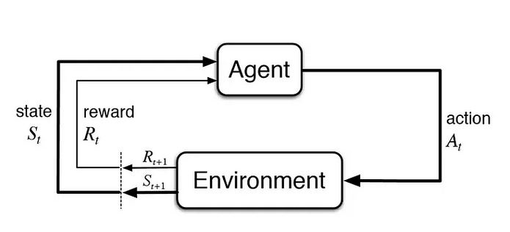
Terminologies
Recurrent Neural Network(RNN):-Also known as RNNs, are a class of neural networks that allow previous outputs to be used as inputs while having hidden states.
Reinforcement Learning:- RL is a type of machine learning technique that enables an agent to learn in an interactive environment by trial and error using feedback from its own actions and experiences.
Test Error Rate:- Test Error rate is expressed as a ratio and is calculated by dividing the total number of pointers read by the total number of errors made in test dataset.
Gradient of P Scale by R:- The gradient of the probability distribution (P) with respect to the parameters of the neural network architecture. This is used in optimization, typically performed using backpropagation. "Scale it by R" suggests that the computed gradients are multiplied by the reward signal (R) obtained from the RL task. The reward is a measure of the performance or success of the agent in the given environment.
Meta Learning:-Meta-learning is a subfield of machine learning where the focus is on training models to be good learners across a variety of tasks or domains. The idea is to design algorithms or models that can adapt quickly to new tasks with minimal data. Example transfer learning.

Slide 5
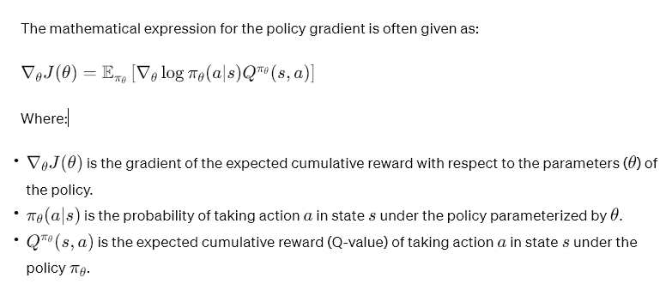
Terminologies Cont.
Meta Architecture:-The meta-architecture defines the general structure of a model that is capable of meta-learning. This might include components for learning how to learn, adaptability to different tasks, and mechanisms for transferring knowledge from one task to another. Meta-architectures often include modules or components that facilitate meta-learning. For example, there might be an outer loop that updates the model's parameters based on its performance across different tasks, and an inner loop that fine-tunes the model on individual tasks.
Weight Sharing:-Weight sharing is a technique used in neural networks where the same set of weights is reused across different parts of the model. Instead of having separate parameters for each part or unit of the network, weight sharing involves sharing the same weights among multiple units or layers.
Network Morphism:-Network morphism refers to a concept in neural network design and optimization where a neural network is transformed or morphed into another network with a similar architecture but different parameters. The idea behind network morphism is to maintain the network's overall structure while allowing for structural changes that can improve performance, adapt to new tasks, or optimize for specific criteria.
Evolving Neural Networks: Evolutionary algorithms, such as genetic algorithms, can be applied to evolve neural network architectures. Through mutations and crossovers, new architectures are generated, and their performance is evaluated
Neural Architecture Search (NAS): Network morphism is related to NAS, where the goal is to automatically discover optimal neural network architectures for specific tasks. NAS often involves morphing or transforming candidate architectures during the search process
Hypernetworks: In the context of hypernetworks, which are networks that generate weights for another network, the concept of network morphism can be used to explore different weight generation strategies while keeping the overall structure constant.
Policy Gradient:-Policy gradient is a technique used in reinforcement learning to optimize the policy of an agent. In reinforcement learning, an agent learns to make decisions by interacting with an environment. The policy is a strategy or a mapping from states to actions that the agent follows to maximize its expected cumulative reward.
Skip Connection:- Skip Connections (or Shortcut Connections) as the name suggests skips some of the layers in the neural network and feeds the output of one layer as the input to the next layers.
Skip Connections were introduced to solve different problems in different architectures. In the case of ResNets, skip connections solved the degradation problem whereas, in the case of DenseNets, it ensured feature reusability.

Slide 6
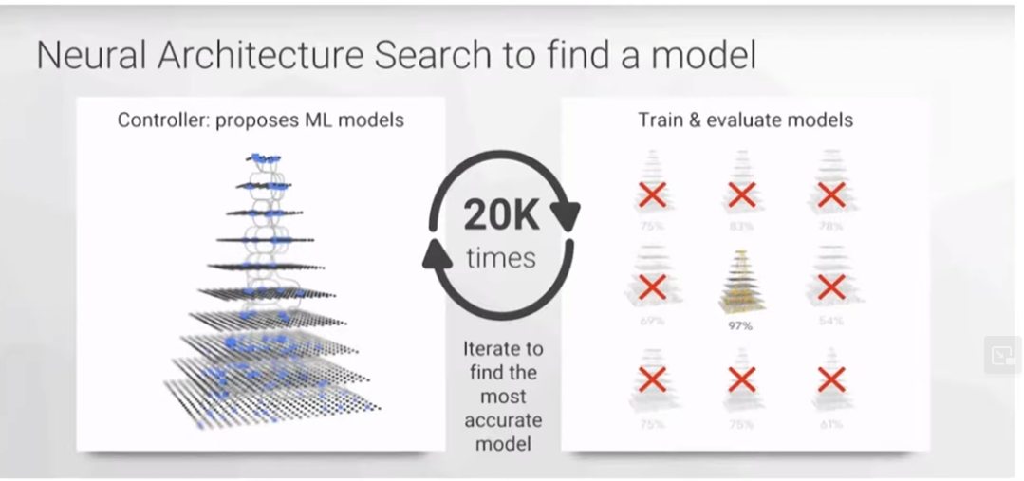
What is NAS?
Neural Architecture Search (NAS) | A gradient-based method employed for discovering effective neural network architectures.
Controller | Utilizes a recurrent network as the "controller" to generate the aforementioned model params
Child Network | The neural network specified by the generated string is referred to as the "child network."
Training Process | The child network is trained on real data, yielding an accuracy on a validation set.
Reward Signal | The accuracy obtained serves as the reward signal for the training process.
Policy Gradient | The policy gradient is computed using the reward signal to update the controller
Iterative Improvement | In subsequent iterations, the controller assigns higher probabilities to architectures with higher accuracies
Learning Process | Over time, the controller learns to enhance its search by favoring architectures with improved performance.

Slide 7
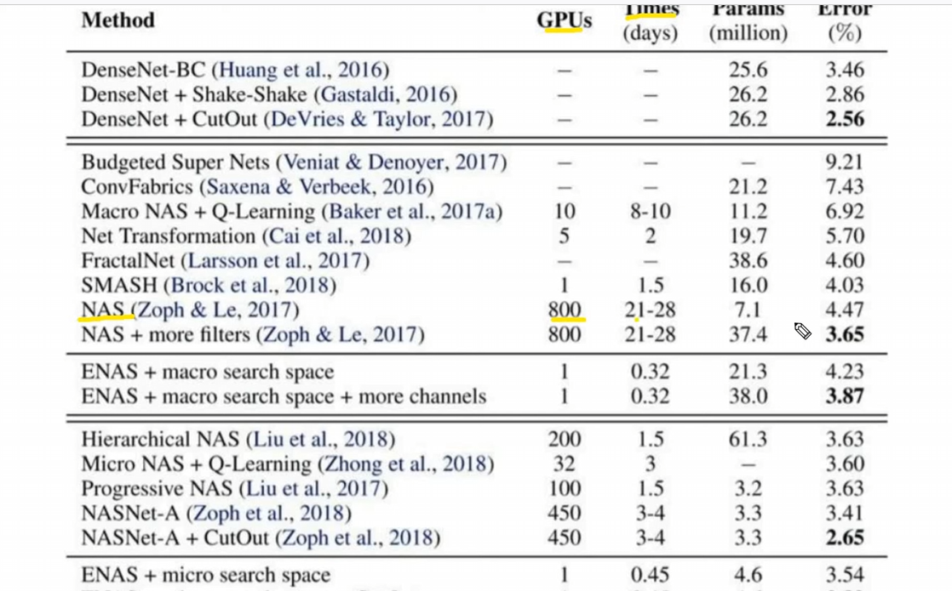
Why NAS?
Hyperparameter Optimization in Deep Learning | Recognized as a crucial method within the realm of deep learning. Despite their success, current methods are constrained as they exclusively explore models within a fixed-length space.
Challenges with Variable-Length Configurations | Existing methods face difficulty in generating variable-length configurations specifying the structure and connectivity of a network.
Importance of Good Initial Models | Practical success of these methods often relies on the provision of a good initial model
Proposed Method in this Paper | Introduces a method that overcomes the limitations of existing approaches, providing greater flexibility in generating variable-length configurations for network structures.

Slide 8
NAS Pros & Gaps
Pros
Gaps
NAS automates the process of designing neural network architectures, reducing the need for manual intervention. | NAS is computationally expensive and often requires significant resources, including powerful GPUs or even TPUs, and large-scale computational clusters.
NAS has demonstrated success in achieving state-of-the-art performance on various tasks, sometimes surpassing architectures designed by human experts. | The vast search space of possible architectures can make NAS challenging and computationally demanding.
NAS methods efficiently explore a vast search space of possible architectures, potentially discovering novel and optimized structures. | The architectures generated by NAS can be complex and lack interpretability.
Architectures discovered using NAS on one task can be transferred or adapted to perform well on related tasks, showcasing a level of generalization. | Some NAS methods might be sensitive to the specifics of the search space and the training procedure.
NAS can be used to find architectures optimized for specific hardware constraints, leading to more efficient models. | NAS often requires large datasets to effectively train and evaluate the performance of different architectures.

Slide 9
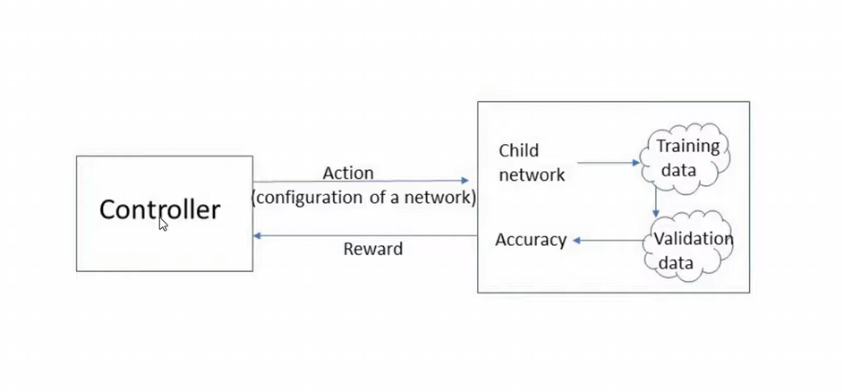
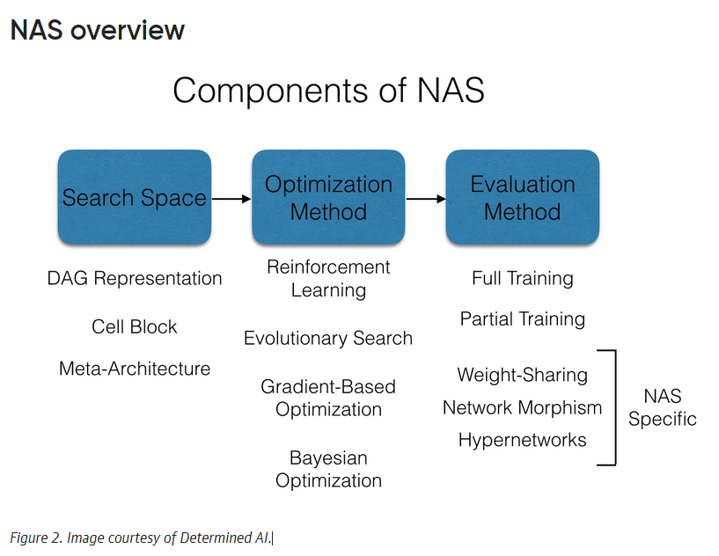
NAS Types
Reinforcement Learning-based NAS | Employs reinforcement learning to train a controller that generates architectures based on a reward signal reflecting their performance. Allows for sequential decision-making in the architecture search process.
Meta-learning-based NAS | Employs meta-learning to train a model that can quickly adapt to new tasks, enabling efficient architecture search. Well-suited for scenarios with limited data for each task.
Differentiable Architecture Search (DARTS) | Utilizes continuous relaxation of the search space to make it differentiable, allowing for efficient gradient-based optimization. Balances the discrete nature of architecture search with differentiability for gradient-based optimization
Random Search
Evolutionary Algorithms
Gradient-based Optimization
Bayesian Optimization
Ensemble-based NAS
Progressive NAS
Network Morphism.
Hierarchical NAS

Slide 10
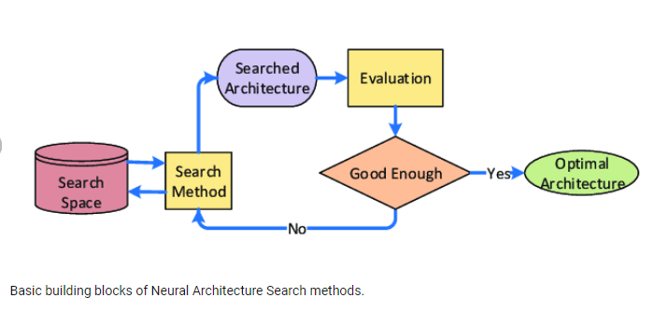
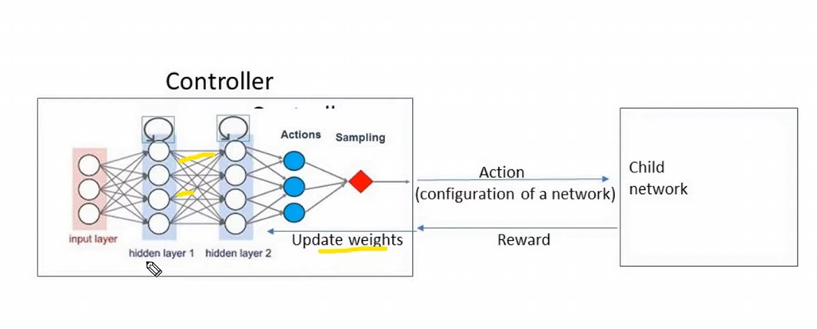
NAS Process
Architectural Hyperparameter Generation | The objective is to use a controller(RNN) to generate architectural hyperparameters for neural networks
Controller Implementation | The controller is implemented as a recurrent neural network (RNN) for flexibility in generating hyperparameters.
Flexibility of the Controller | The flexibility of the controller allows it to adapt to various architectural configurations.
Sequence Generation | The controller generates hyperparameters in the form of a sequence of tokens.
Tokenized Representation | Each token in the sequence corresponds to a specific architectural hyperparameter, enabling a structured representation.
Adaptability to Network Structure | The approach is adaptable to different network structures, as indicated by the focus on predicting feedforward neural networks with convolutional layers.
Versatility in Application | The described controller can be applied to a range of tasks involving the generation of architectural hyperparameters for neural networks.

Slide 11
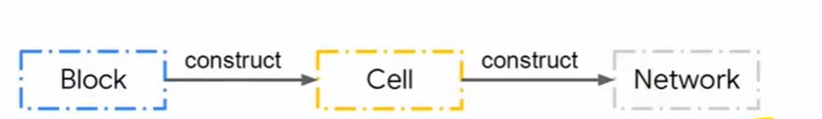
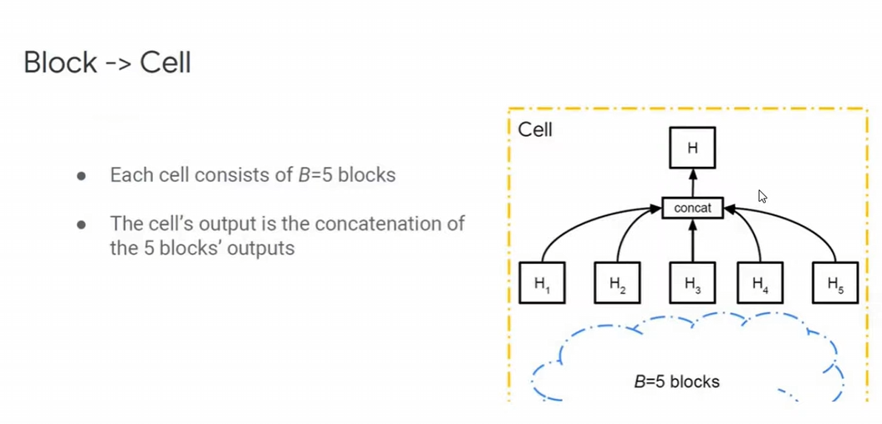
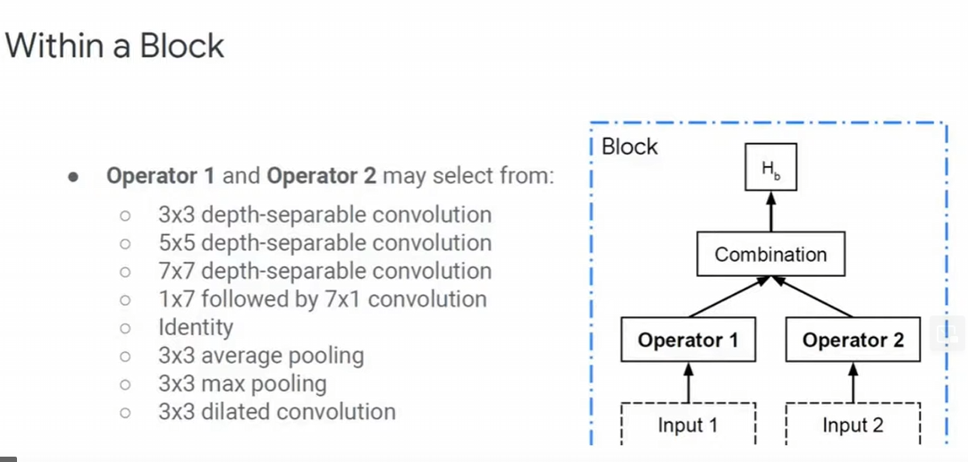
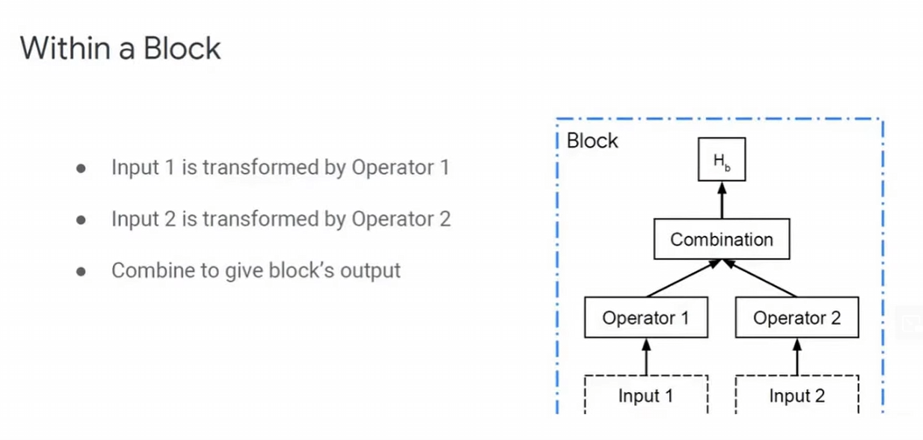
NAS Methodologies
The recurrent network can be trained with a policy gradient method to maximize the expected accuracy of the sampled architectures.
Forming skip connections to increase model complexity and using a parameter server approach to speed up training.
A controller to generate architectural hyperparameters of neural networks. The controller is implemented as RNN.
To predict feedforward neural networks with only convolutional layers, we can use the controller to generate their hyperparameters as a sequence of tokens.
The controller RNN finishes generating an architecture, a neural network with this architecture is built and trained.
The parameters of the controller RNN, θc, are then optimized in order to maximize the expected validation accuracy of the proposed architectures.

Slide 12
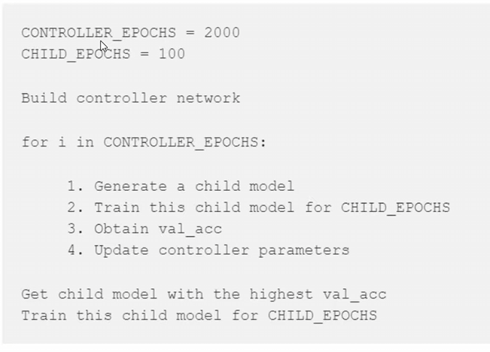
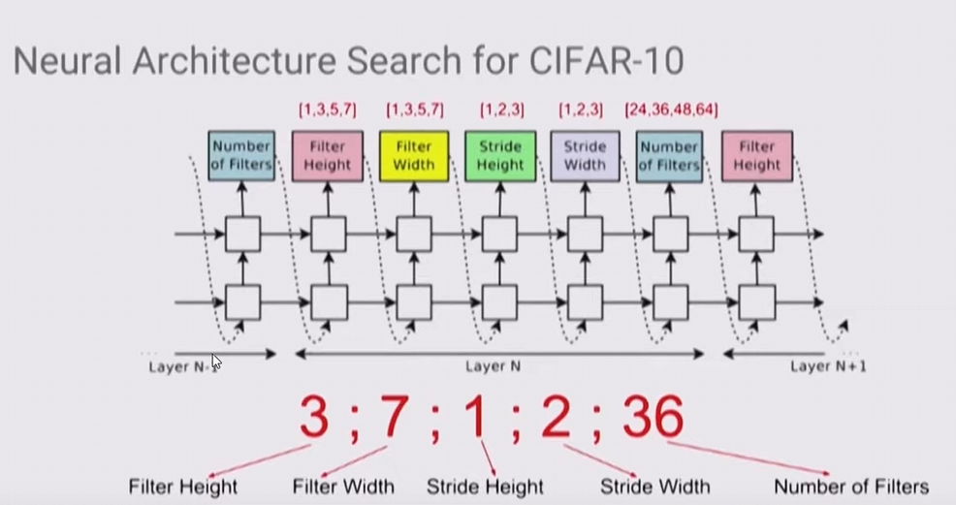
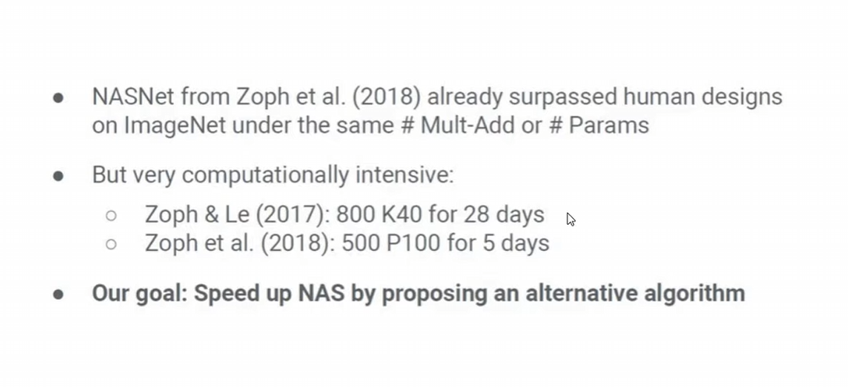
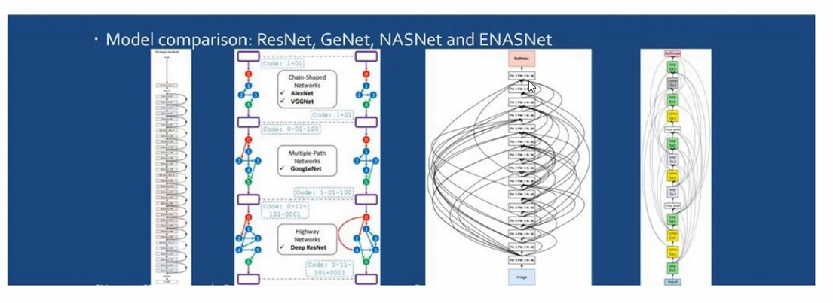
NAS Methodologies

Slide 13
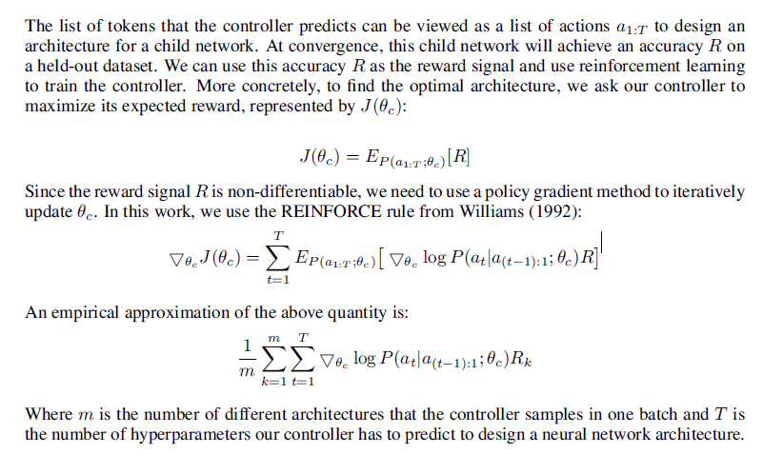
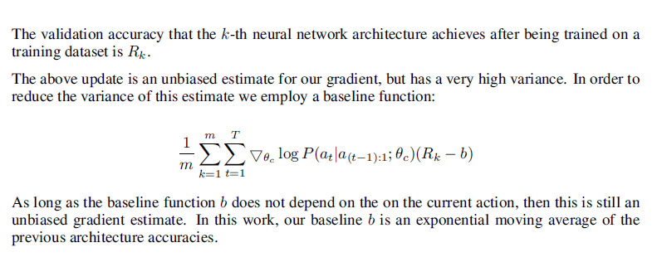
Training with RL
What’s Happening Above??
1.The overall expression represents the gradient of the policy with respect to its parameters, and the goal is to update the parameters in the direction that increases the expected cumulative reward. This is a key step in the policy gradient optimization process used in reinforcement learning and neural architecture search.
2.The overall expression represents the policy gradient objective, where the goal is to adjust the parameters θc​ of the policy to maximize the expected cumulative reward(accuracy) , taking into account multiple trajectories and a baseline to reduce variance in the gradient estimate. This type of formulation is commonly used in reinforcement learning for training policies in sequential decision-making tasks.

Slide 14
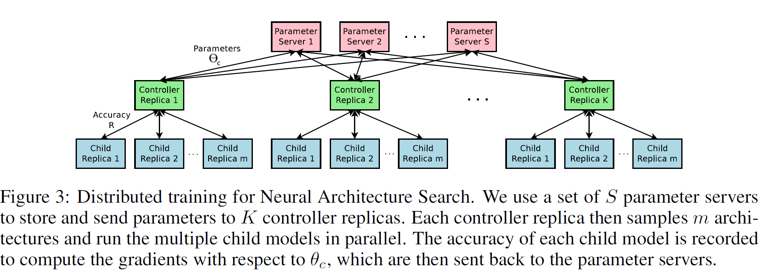
Accelerate Training with Parallelism and Asynchronous Updates
As training a child network can take hours, we use distributed training and asynchronous parameter updates in order to speed up the learning process of the controller , in this paper used a parameter-server scheme where they have a parameter server of S shards, that store the shared parameters for K controller replicas. Each controller replica samples m different child architectures that are trained in parallel. The controller then collects gradients according to the results of that minibatch of m architectures at convergence and sends them to the parameter server in order to update the weights across all controller replicas. In this implementation, convergence of
each child network is reached when its training exceeds a certain number of epochs.

Slide 15
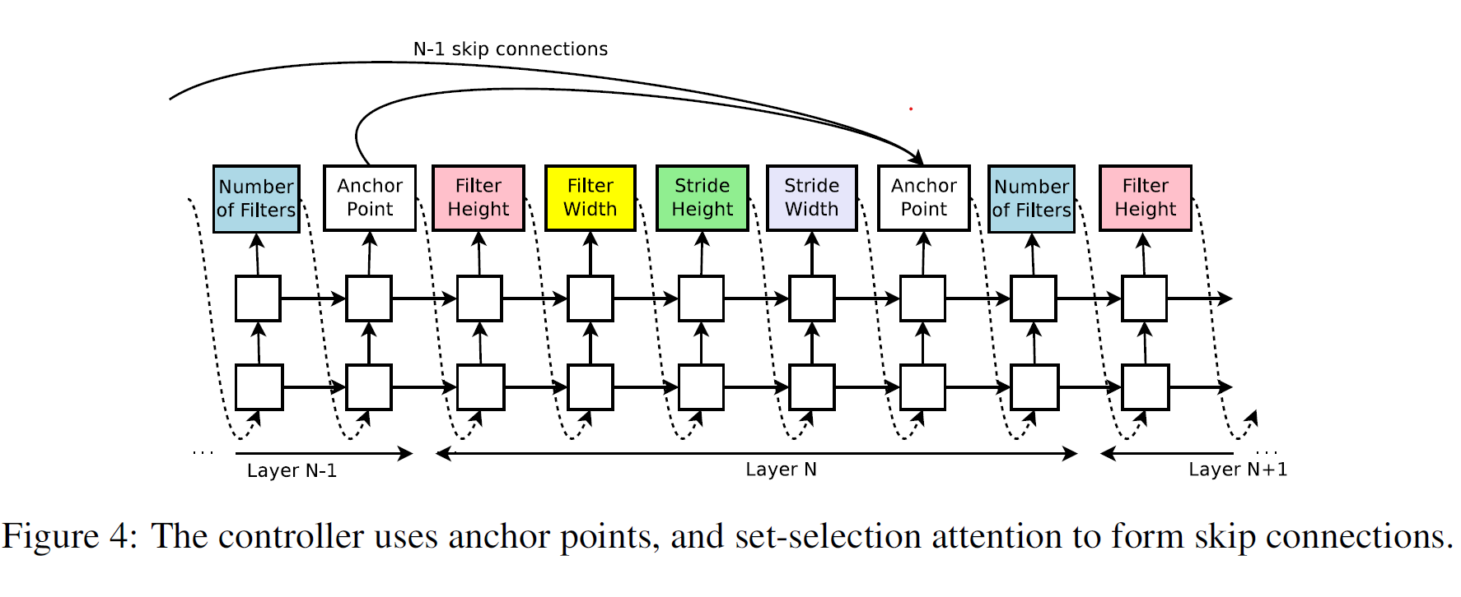
Increasing architecture complexity with skip connections and other layer
Introduces a method that allows our controller to propose skip connections or branching
layers, thereby widening the search space. At layer N, we add an anchor point which has N − 1 content-based sigmoids to indicate the previous layers that need to be connected. Each sigmoid is a function of the current hidden state of the controller and the previous hidden states of the previous N − 1 anchor points

Slide 16
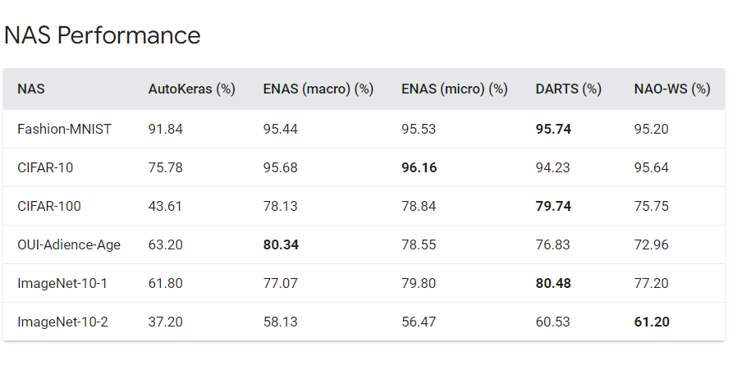
Demo
https://github.com/ashishodu2023/NAS
https://github.com/google/model_search.git

Slide 17
References
https://www.geeksforgeeks.org/neural-architecture-and-search-methods/
https://www.youtube.com/watch?v=NQj5TkqX48Q
https://www.youtube.com/watch?v=UlvkBZdOhpg
https://www.automl.org/nas-overview/
https://en.wikipedia.org/wiki/Neural_architecture_search
https://www.infoworld.com/article/3648408/what-is-neural-architecture-search.html
https://lilianweng.github.io/posts/2020-08-06-nas/
https://deci.ai/neural-architecture-search/
https://www.oreilly.com/content/what-is-neural-architecture-search/
https://www.researchgate.net/figure/Basic-building-blocks-of-Neural-Architecture-Search-methods_fig1_352621860
https://nni.readthedocs.io/en/stable/sharings/nas_comparison.html
https://stanford.edu/~shervine/teaching/cs-230/cheatsheet-recurrent-neural-networks
https://towardsdatascience.com/reinforcement-learning-101-e24b50e1d292

